Slide 1


BOPHELO HEALTH

Slide 2

COMPANY OVERVIEW
CREATIVE
SOLUTIONS
FOR ALL YOUR
TECHNOLOGICAL
PROBLEMS
Msebetsi Solutions is a software development firm created by Tshepo Nkoe in 2014,Based in Sandton, It was conceived with the aim of developing innovative technology, to solve challenges Africa faces.

Slide 3
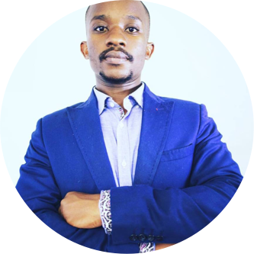
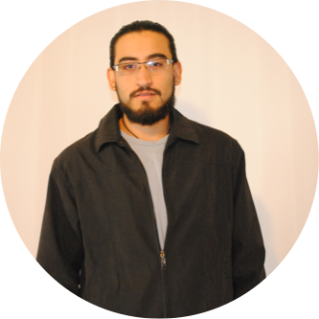


MEET THE TEAM
Msebetsi Solutions
DAVID ASIEGBUNAM
Rabe Nevhutalu
TSHEPO NKOE
CARLOS HERRERA
Director & Visionary
Extraordinary Entrepreneur and Computer programmer,
Software Architect
Graduated as a Software Developer from CTI education Group , Proficient in 6 Programming Languages
User Interface Designer
Incredible Graphic Designer and Computer Programmer
User Interface Designer
Incredible Business Women and Facilitator

Slide 4
COMPANY OVERVIEW
Presentation Goals
Revitalise and restructure all Public health hospital in south africa.
Improve the daily functionality of the hospital by digitising the functions and adapting them to the workflow of the hospital .
The system will give management credible and accurate information reports at any given time.

Slide 5
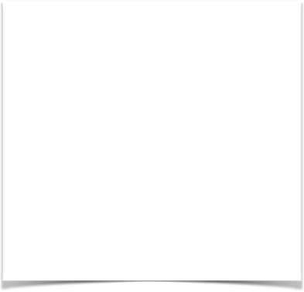
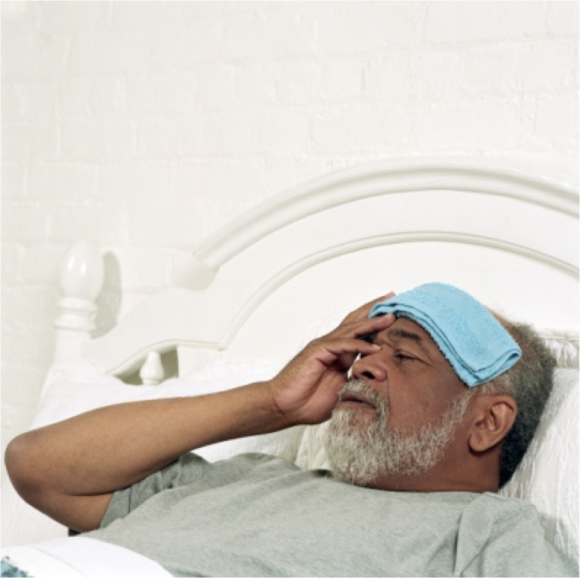
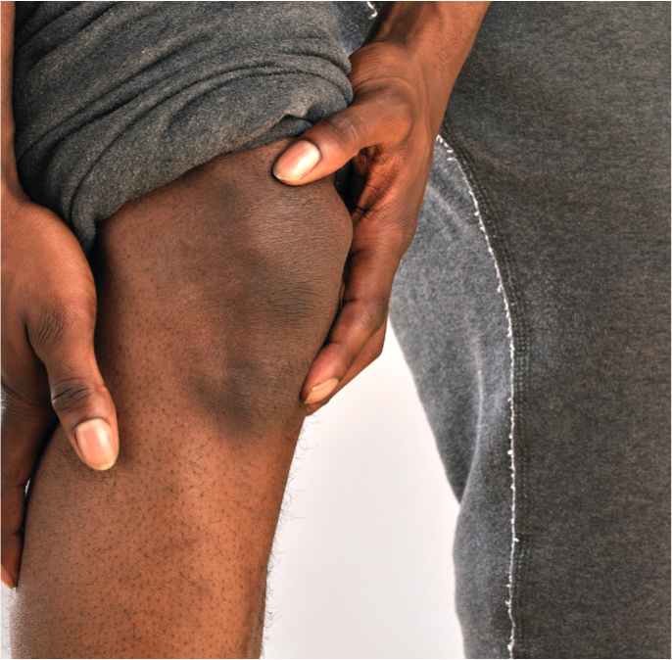
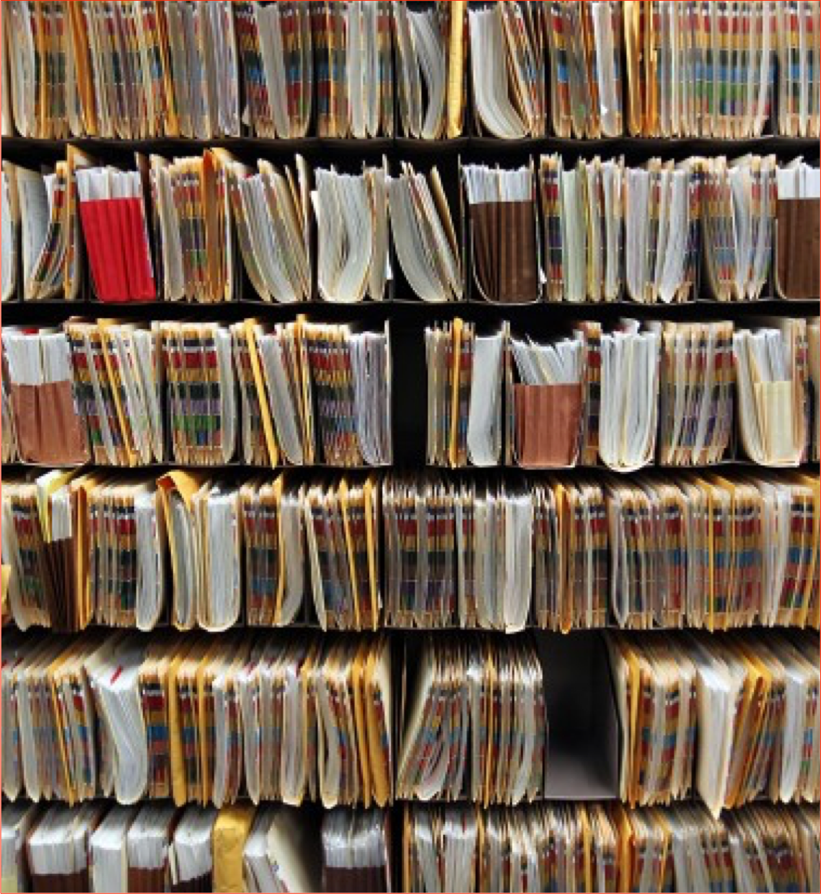
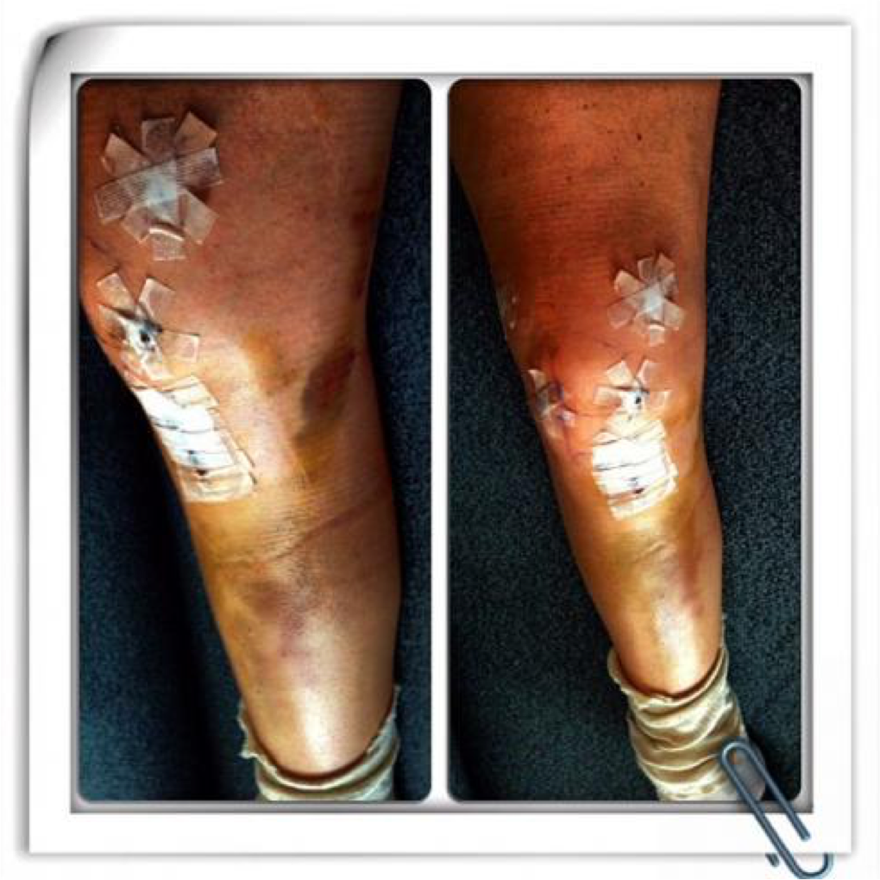
THE PROBLEM
“The growth in Africa’s population in the last decade has not been accompanied by the necessary structural transformation”
Dr. Pali Lehohla
To develop an effective solution for a problem it must be clearly defined, after extensive research we identified the following challenges that the public health sector faces.
- Prescription Integrity
- Inefficient Inter-department communication
- Patient Files Loss
- Appointment Conflicts
- Under staffed hospitals and clinics
- Under and over stocked medication

Slide 6

THE
STORY
I realised the need of this system when I visited Polokwane Provincial Hospital in March 2016. I left Gauteng to get medical attention from my home province in Limpopo. When I got there, I opened a new file and was told to come back after 3 weeks. When I went back 3 weeks later, I was fortunately third in line and thought I would get treated that day, but sadly I was informed that my file was lost and I had to open a new one and had to set a new appointment.
While waiting, I met a man who was involved in accident, who was transferred to Polokwane Provincial Hospital from a local hospital. Some of the screws in his leg were lose and were causing him excruciating pain, but his file could not be found, so he had lost his medical history and had to open a new file, and could only see the doctor after 3 weeks.
Unfortunately, I am not the only one in my family who could not get medical attention because of a lost file. My grandmother, who has eye problems was also turned down on many occasions because of a misplaced file.
All these placed a huge burden on my heart to develop a system that will solve all these issues.
Necessity is the mother of all inventions.

Slide 7
WHY
WE
STAND
OUT
We have created an innovative solution for healthcare administration, but what MAKES US DIFFERENT?
We are African, being directly impacted by these issues, having first hand experience with healthcare Administration in our country , this has enabled us to customise our software to meet South Africa’s needs
2. We are advocates for sustainable growth and change
3. We are highly skilled

Slide 8
“A good Health Care System, contributes to a productive Workforce"
Mark Twain

Slide 9
LET'S TALK ABOUT DATA
Reliance on Public Health Sector
PIE CHART DATA
80% of South Africans rely on public health sector.

Slide 10
LET'S TALK ABOUT DATA
Birth registration & Patients per clinic
For the year 2015 current birth registrations decreased to 919 562.
Thats 2520 unregistered babies per day.
2015
People per clinic is 13 718, exceeding WHO guidelines of 10 000 per clinic.
2015

Slide 11
LET'S TALK ABOUT DATA
Almost all perinatal deaths are preventable if a woman receives efficient quality health care
There is just one practising doctor for every 4 219 people.

Slide 12

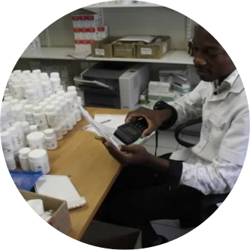

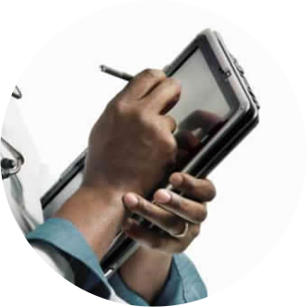
ELECTRONIC FILE-KEEPING
System will create electronic files for patients ,store old files and keep a record of each patients medical history .
Bophelo Health
Features
MEDICATION INVENTORY LIST
keep track of medication in a pharmacy and notify pharmacists when they should reorder.
4
3
1
APPOINTMENT BOOKING
Every Doctor and Administrative staff can book appointments for patients.
Health Care Features
2
The following are features that are included in the software.
PRESCRIPTION DATABASE
Every prescription given by a doctor is stored in the patients digital file. To give Doctors a more Holistic background for diagnosis.

Slide 13

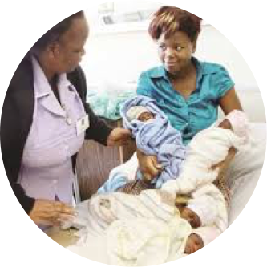


Electronic Admittance & Discharge
keeps a record of every patient admitted and discharged at the hospital ,and automatically updates into the Patients file.
Features
Birth and Death Declarations
Enables the hospital to inform management of the amount of babies born & the Amount of people who pass away at each hospital .
8
7
5
Electronic Vitality Check
Nurses are able to store and update vitality results automatically into the Patients files.
Msebetsi Solutions
6
CREATIVE SOLUTIONS FOR ALL YOUR TECHONOLOGICAL PROBLEMS .
MOBILE, TABLET AND COMPUTER INTEGRATION
Can be viewed on Laptops,Tablets and Cell phones.

Slide 14
TECHNOLOGICAL
BREAKTHROUGH
Technological Advancement For the Hospital
We believe that Bophelo Health will be a breakthrough advancement in technology for hospitals and our country that will revitalise and restructure the South African health care system.
@
Strategy
To ensure efficient world class service delivery to all patients in the public health sector all over South Africa.
SMS
Customer Satisfaction!
Guaranteeing a 100% Patient satisfactory rate from all Government hospitals.

Slide 15
END

